Slide 1
Roots of Bangladesh up to 1757: Major developments emphasizing exclusiveness of Bengal
Aynul Islam
Associate Professor

Slide 2
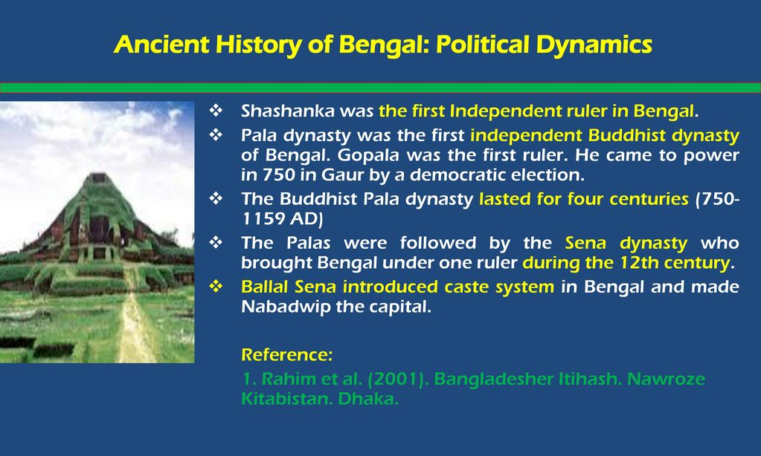

Slide 3

The Pala Dynasty, (750AD-1097AD)
The long Buddhist rule of the Palas generated an environment of ‘religious tolerance in Bengal and an atmosphere of Hindu-Buddhist amity and co-existence’
Their liberal patronage of Hindu gods and goddesses as well as Brahmans, who were employed in high state posts, clearly speak of the sagacious policy of the rulers.

Slide 4
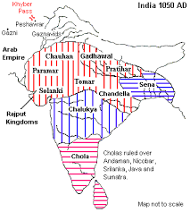

Slide 5
The Sena Dynasty (1097 AD-1204 AD)
Vijoy Sena founded the Sena empire.
The Senas held sway over Bengal for more than a century (c1097-1223 AD) in which five generations of kings
But it must be noted that the invasion of Bakhtiyar Khalji put an end to Sena rule in parts of western and northern Bengal (in 1204 AD) and Luxmanasena had to fall back on his possessions in southeastern Bengal where, after him, his two sons ruled for some time.
The period saw the development of Sanskrit literature in Bengal.
It was partly under the direct patronage of the Sena kings and partly due the environment created by them that literary activities in Sanskrit are distinctly visible in this period.
Another arena of artistic achievements in the period was in the field of sculptural art. The Bengal school of sculptural art reached its high-water mark in the Sena period…

Slide 6
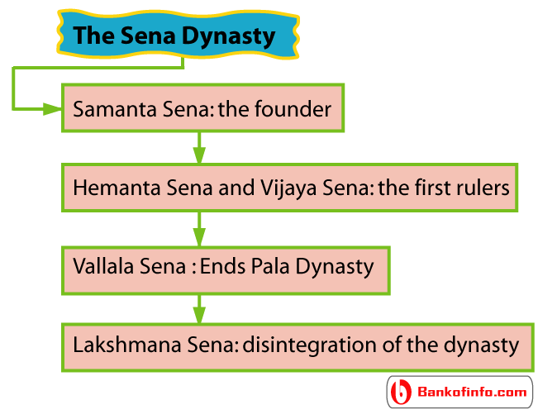

Slide 7
Medieval Bengal
Early Sultanate Period
The Muslim rule in Bengal had its beginning in the opening years of the thirteenth century (1204 AD). The process of Muslim expansion in Bengal began with the military exploits of Bakhtiyar Khalji.
The Initial period (1206-1227 AD): Bakhtiyar's death was too sudden to enable him to pay any attention to the question of succession.
Rule of the Independent Sultans in Bengal (1338-1538)

Slide 8
Iliyas Shahi Period, 1342-1487
The dynasty founded by Iliyas Shah ruled Bengal for nearly one hundred and fifty years (1342-1487 AD)
The Independent Sultanate, inaugurated by Fakhruddin Mubarak Shah, was consolidated and witnessed widespread expansion.
The Muslim administration was given a distinct shape in this period.
Arts and literature, particularly Bangla literature, flourished.

Slide 9
The Muslim rulers were obliged to take the local people into confidence and opened the door for their participation in the administration of the country.
The process of transformation of Alien Muslim rule into Bengali Muslim rule was started during this period.
Significantly, the whole territory, which was hitherto known not by any unitary name but by its different regional names such as Vanga, Gauda etc, came to be designated as Bangalah.

Slide 10
Husain Shahi Rule, 1494-1538
Husain Shahi rule was characterized by territorial expansion, stabilisation of administration and significant developments in religion, literature, the arts and the economy.
In this period Bengal's political isolation from North India reached its culminating point, and this helped her to reinforce her cultural identity…(Distinct)
….The period saw the advent of the Europeans in Bengal. The period witnessed the initial signs of the new forces that were destined to shape the life of the country for centuries to come. In that sense the period represents a 'formative period' of Bengal history.

Slide 11
Mughal period upto 1757
Mughal rule was established in Bengal after the defeat of the Karrani Afghan Sultan Daud Khan in the battle of Rajmahal, 12 July 1576 at the hands of Khan Jahan.
With Khan Jahan's victory over Daud Khan, the Mughals made determined and sustained efforts to establish their authority over Bengal, till ultimately in 1612, Islam Khan Chishti brought the whole of Bengal (except Chittagong) under the Mughal control.

Slide 12
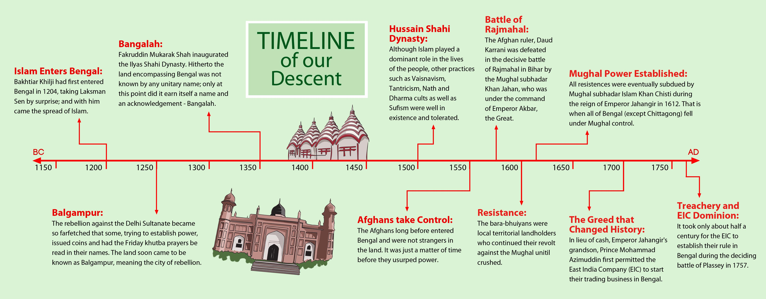

Slide 13
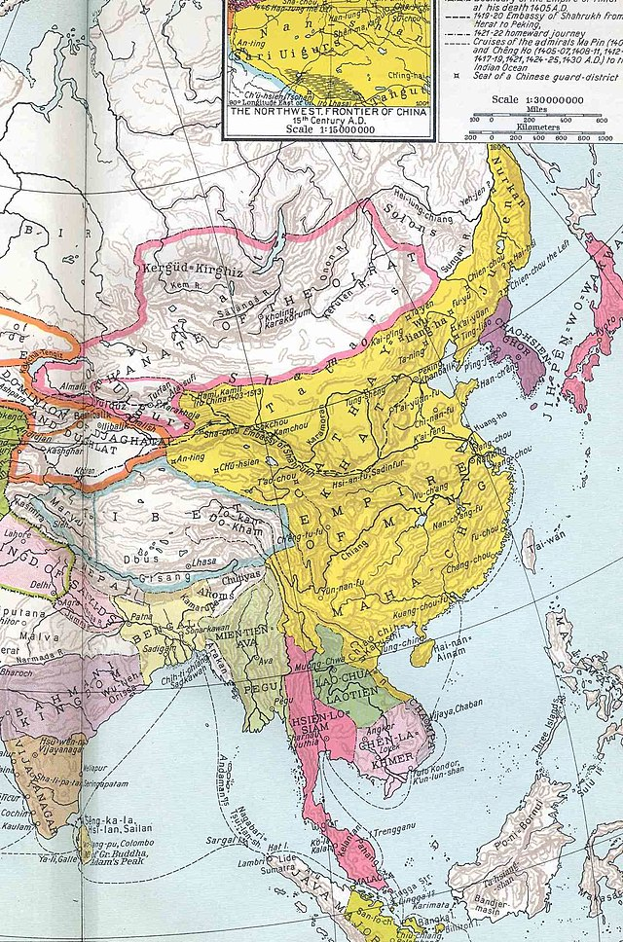

Slide 14
The Battle of Plassey 1757 in Bengal and the transition to Colonial Rule in the Sub-continent…

Slide 15
Early history of European companies
Most company charters dated back to Mughal times—the EIC received theirs from Jahangir, due to Portuguese pressures
Several “companies” scattered throughout South Asia, most were simple trading posts
Intense competition in the trade of textiles, saltpeter, sugar, and indigo by 18th C

Slide 16
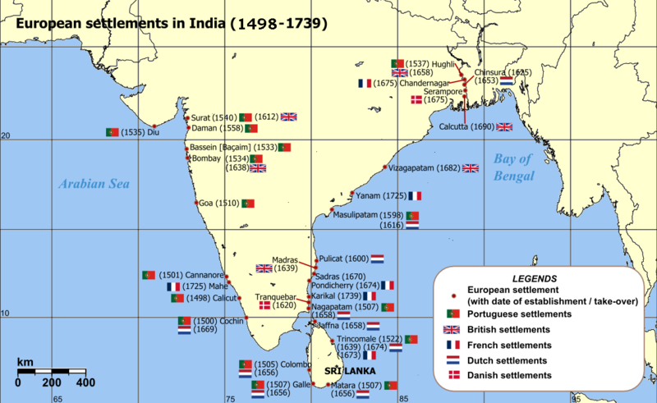
European settlements in India (1498-1739)

Slide 17
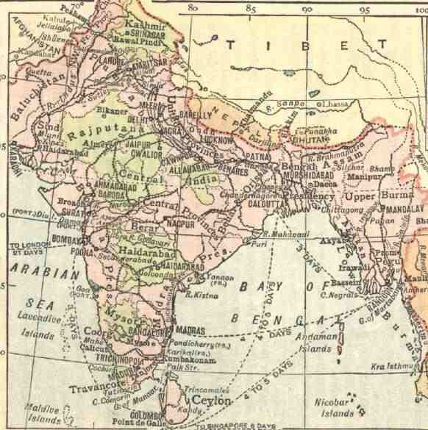

The East India Company
East India Company was the name of several historical European companies chartered with Asia, more specially with India.
British East India Company, founden in 1600
Danish East India Company, founded in 1616
Dutch East India Company, founded in 1602
French East India Company, founded in 1664
Swedish East India Company, founded in 1731
Portuguese East India Company, founded in 1628

Slide 18
First it was called Honorable East India Company (HEIC) or often ”John Company”. Based in London.
An early joint-stock company, which was granted an English Royal Charter by Elisabeth I. on December 31, 1600.
Queen Elisabeth granted the monopoly rights to bring goods from India.
The Royal Charter gave the newly created HEIC a 21 monoply on all trade in the East Indies.
The Company had 125 shareholders, and a capital of £72,000…

Slide 19
The Battle of Plassey was fought on 23 June 1757. It was fought between the Nawab of Bengal and the British East India Company in which the East India company emerged victorious. This battle led to the establishment of Company’s rule in India and Bengal. The battle took place at Palashi, Bengal on the banks of the Bhagirathi river, near Murshidabad, then capital of the undivided Bengal. The two forces of were Siraj-ud-Daulah, the last independent Nawab of Bengal, and the British East India Company.

Slide 20
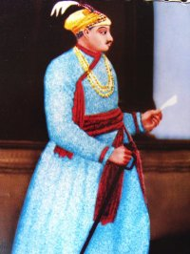
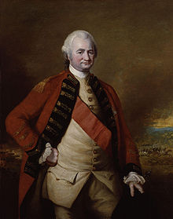
Nawab Siraj-ud-Daulah
Colonel Robert Clive

Slide 21
Black Hole Incident
The Black Hole of Calcutta was a small dungeon in the old Fort William, at Calcutta, India, where troops of the Nawab of Bengal, Siraj ud-Daulah, held British prisoners of war after the capture of the Fort on June 19, 1756.
One of the prisoners, John Zephaniah Holwell, claimed that following the fall of the fort, British and Anglo-Indian soldiers and civilians were held overnight in conditions so cramped that many died from suffocation, heat exhaustion and crushing. He claimed that 123 prisoners died out of 146 prisoners held.

Slide 22
Significance…
No military significance
A decisive historic battle
Beginning of the new era
Economic gains of the English
Helped in the defeat of the French

Slide 23
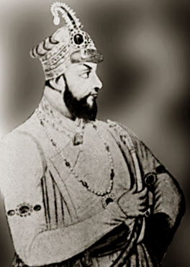
Transformation in the nature of the east India Company
The puppet government of Mir Jafar
Mir Jafar Nawab of Bengal (1757-1760)

Slide 24
Personal gains of Clive
Weakness of Indian Political system exposed
Opening way for new struggles
Set back to the supremacy of Mughal Emperor
Enhanced the prestige of the company.

Slide 25
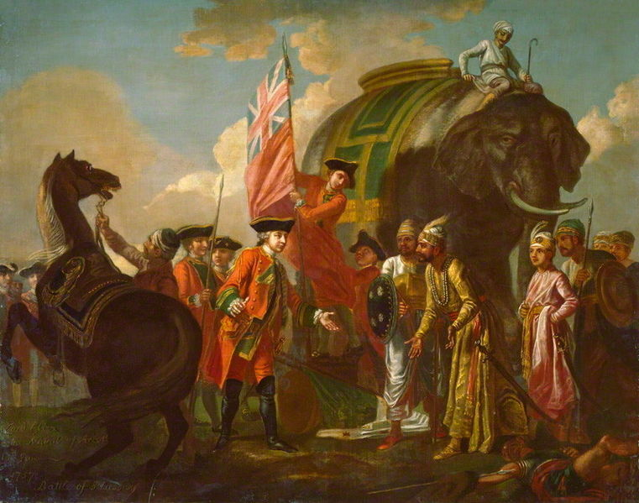
Lord Clive meeting with Mir Jafar after the Battle of Plassey

Slide 26
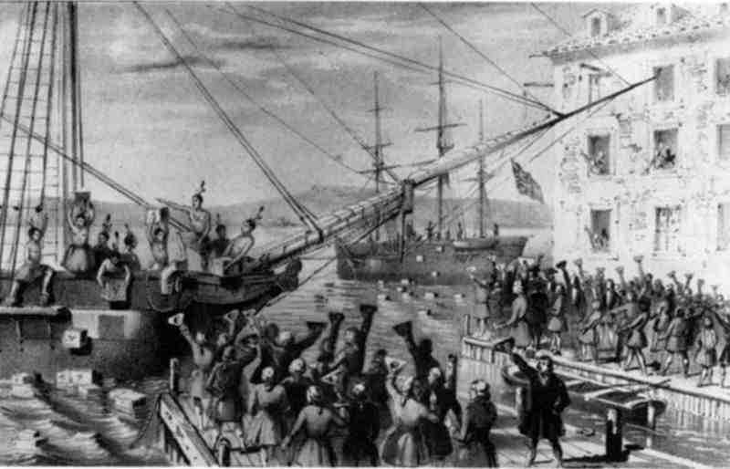
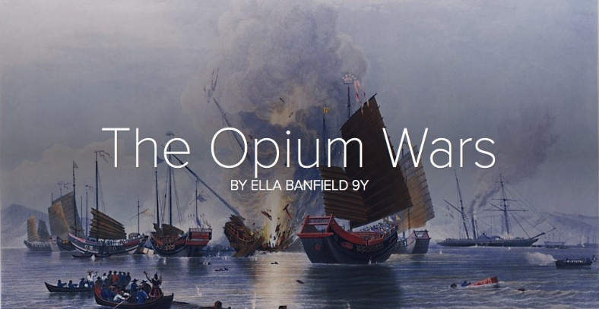
Thwe Opium ‘Monopoly’
It was used as medicine and smoked with tobacco.
England could grow opinum in India and the transport it home.
In the 18th century, England had a huge trade deficit with Qing Dynasty China and so in 1773, the Company created a British monopoly of opium trading in Bengal
As opium trade was illegal in China, Company ships could not carry opium to China
The opium produced in Bengal was sold in Calcutta on condition that it be sent to China

Slide 27
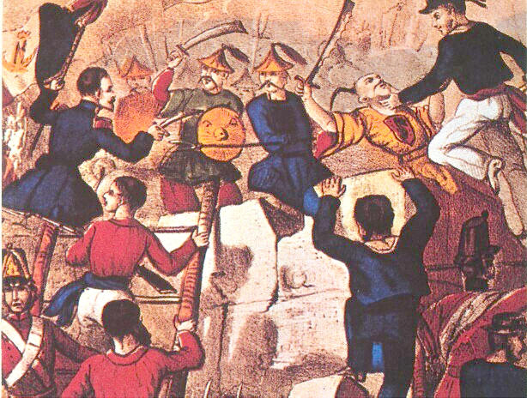
Despite the Chinese ban on opium imports, reaffirmed in 1799, it was smuggled into China from Bengal by traffickers and agency houses averaging 900 tons a year
Eventually this led to the The first Opium War (1839-42). Not only were the Chinese defeated but the British seizing Hong Kong and opening of the Chinese market to British drug traffickers.
1856: The second Opium War – France and the EIC won against China

Slide 28
